Slide 1
BlockChain Elements
To understand BlockChain you have to understand Below concepts
Peer to Peer network
Cryptography
Hashing

Slide 2
Centralized Control Examples
Facebook
Paytm –you have to link with bank

Slide 3
Block Chain based on
Peer to Peer network(P2P)
No centralized control
Example Napster for sharing music album
Torrent
Bitcoin

Slide 4
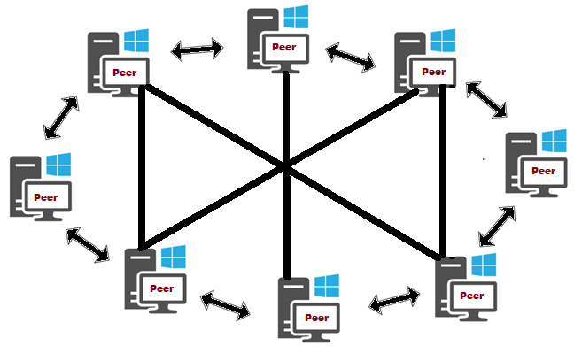
P2P

Slide 5
Drawbacks of P2P
Confidentiality
Authenticity
Non repudiation
Integrity
Notes:
Confidentiality(A sends B through open network can be read by c)
Authenticity-Msg sent by a or c sent message on behalf of A.
Non repudiation-A deny I did not send message to B
Integrity- Temporing of message by c

Slide 6
Solution is Cryptography based on encryption and decryption
A sends message to B
Step 1- A convert data into Non Readable data(Ciphertext) using key
Step2-B receive uses the key to read the received non readable data from A

Slide 7
Types of Cryptography
Symmetric Key-Same key to Encrypt and Decrypt and use different key to send to send c. As the number of users increases generate different keys.
Asymmetric Key- (Private key and public key)
Encrypt –private key
Decrypt-public key
A Encrypt the message with public key of B no one can decrypt it

Slide 8
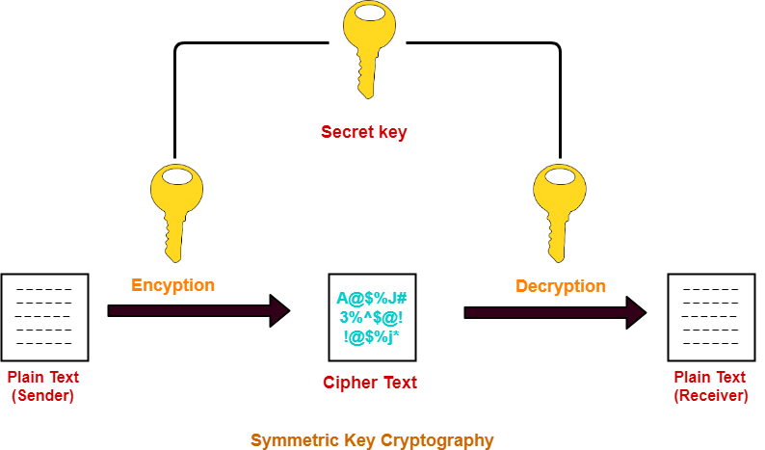

Slide 9
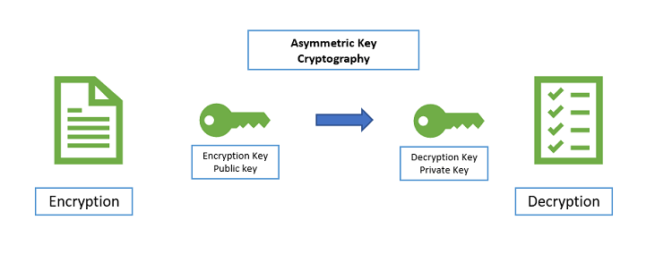

Slide 10
Hashing
Hash Function that takes any arbitrary length input and gives fixed length string as output
Hash function Uses Algorithm
Can use ShA256,MD5
Even a minor change in input gives different hash value
We cant retrieve input from output (hashing irreversible)
Therefore it is not same as encryption bcz while hashing we loss data
We can also get same hash value(hash collision)
We use this hash value in Block Chain
We use SHA2-256(output 256 bits),512(output 512 bits)

Slide 11
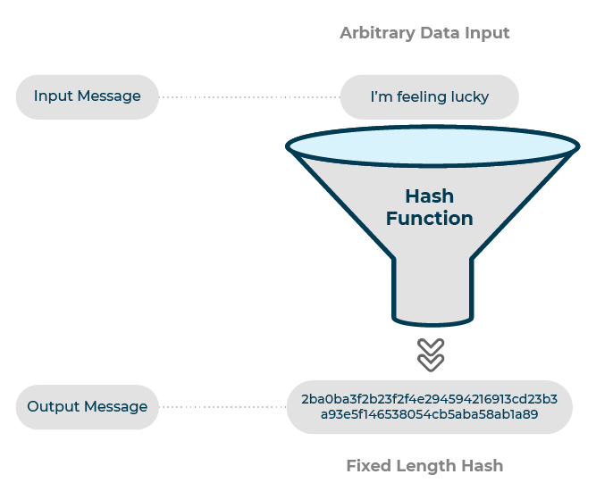

Slide 12
Why BLOCKCHAIN?
How can we say something is fake or original
We can check the validity of this from central authority
What about if central authority changes some data(changes in records)
Therefore Bitcoin introduced records of money that are kept by Everyone(Decentralization)reduces the risk of corruptiond.

Slide 13
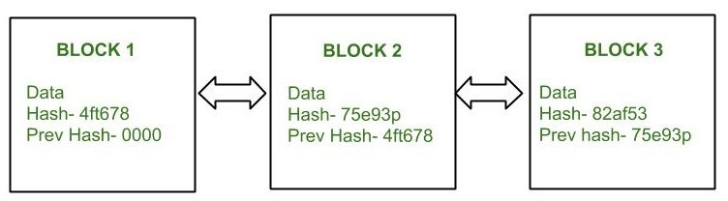
Blockchain is solution to Centralization
A ledger is maintained by Public.
Each page of Ledger is called Pages.

Slide 14
More About Blockchain
Chain of blocks
Considered digital timestamp
Distributed ledger visible to everyone
Once the data is recorded in block it is very difficult to change
Block –transaction data and hash---data changes hash changes
First block is genesis block
Blockchain used for Proof of work
Every node receive chain of blocks in p2p network
If someone create new node it is distributed to all
If someone temper with any block he has to make whole chain correct and get proof of work from other nodes
Example smart contracts to exchange money
Store medical records

Slide 15
More about Blockchain
Technology behind Bitcoin(digital currency) ,hospitals, Govt. Info.,Proof of concepts, Banks
No central bank
Problem with this (Trust-ledger on every machine), (security-Asymmetic cryptography)
lot of transactions can be stored one block moment you change will changes the hash value.

Slide 16
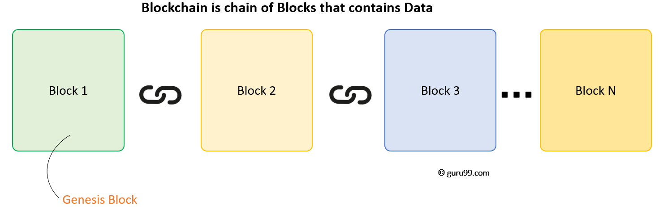

Slide 17
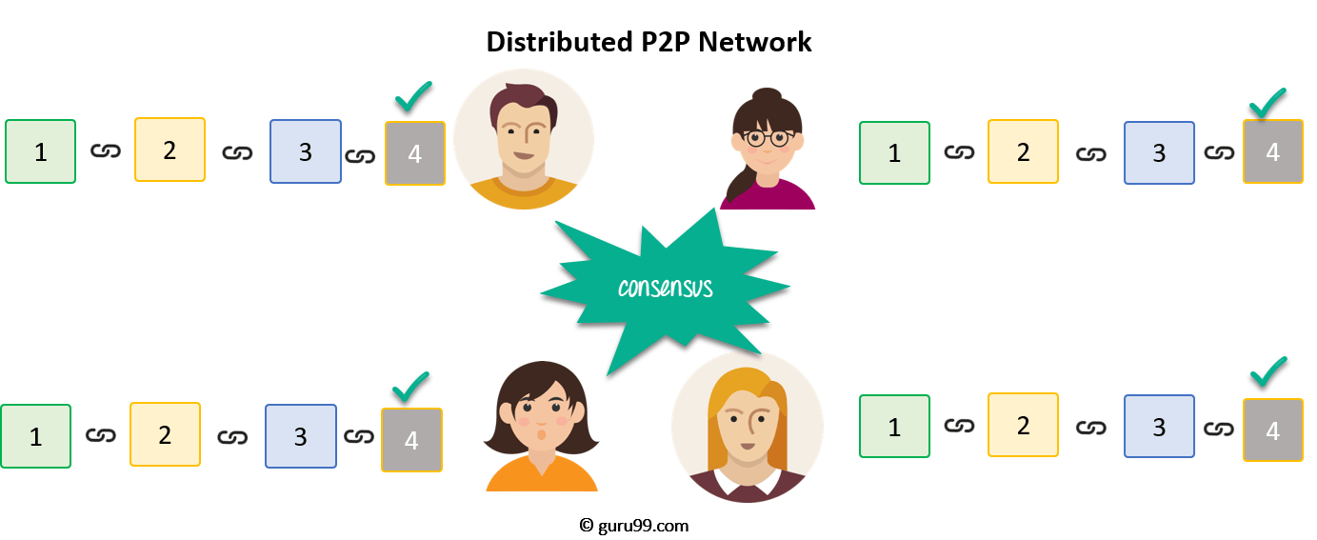

Slide 18
